Slide 1
Technical presentation
Companerobots

Slide 2
Features
01
02
03
04
Musicians controlled by our given gestures
Synchronization
Thanks to laser senzor, we can command robots to play in different tempo, and different sounds not only by code but also by out gestures
Each robot is synchronized by esp-now with the main “server”, the raspberry pi. That gives him almost realtime updates about stage and tells him how to react to upcoming events.
Visual and sound effects
Camera controlling dancer
The robots actually plays on the instruments, not only move randomly with their hands and play the songs on loudspeakers
The dancer robot can copy your movements with his mechanical parts. Of course only if you are in front of the camera which communicates with it.

Slide 3
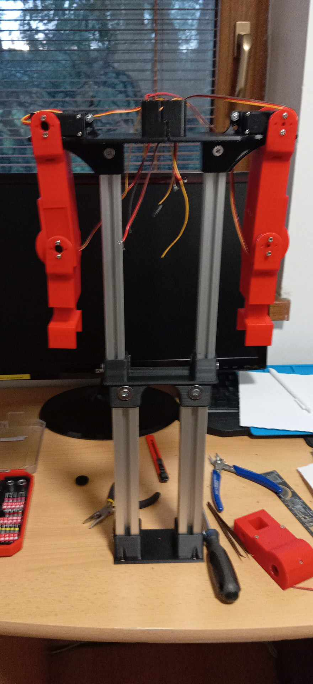
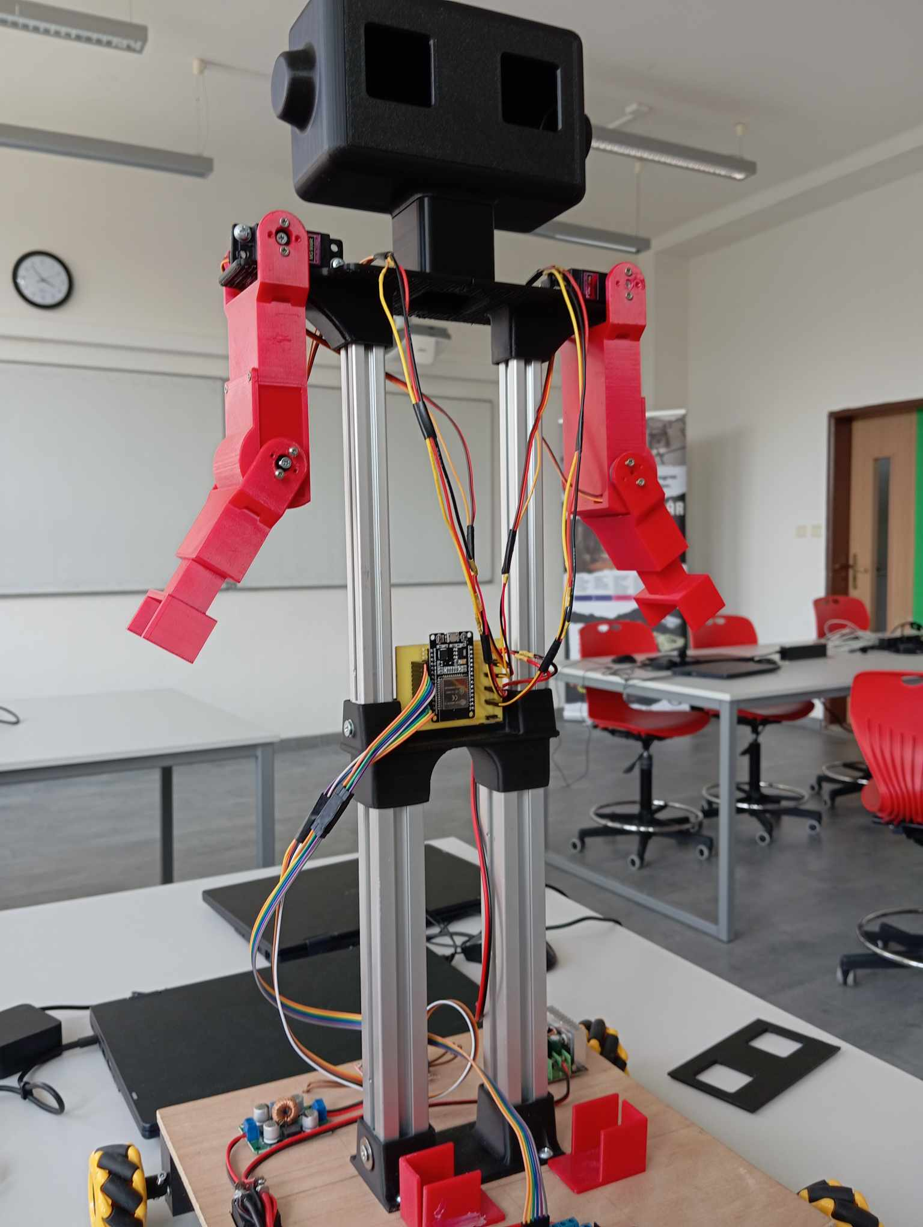
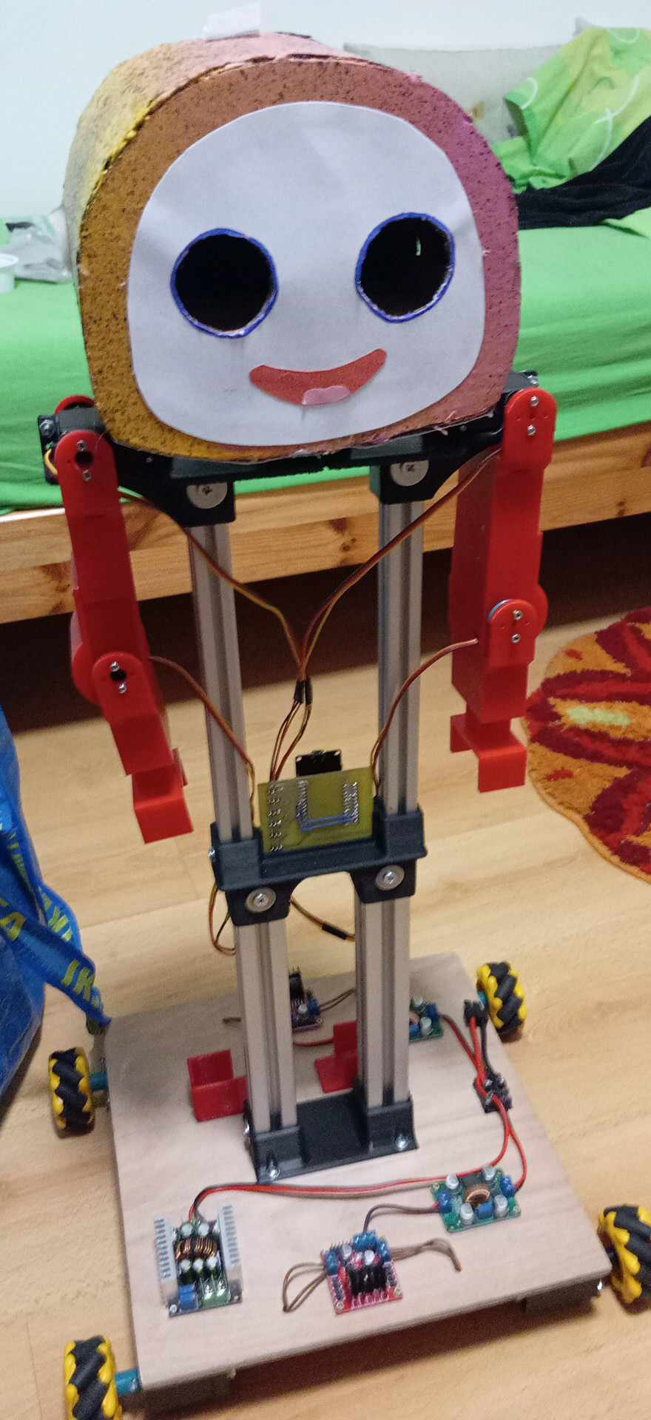
Dancer
3D printed parts
mg996 servos
ESP32
wheels
step up converters
3D printed battery holder
motor drivers
step down converter

Slide 4
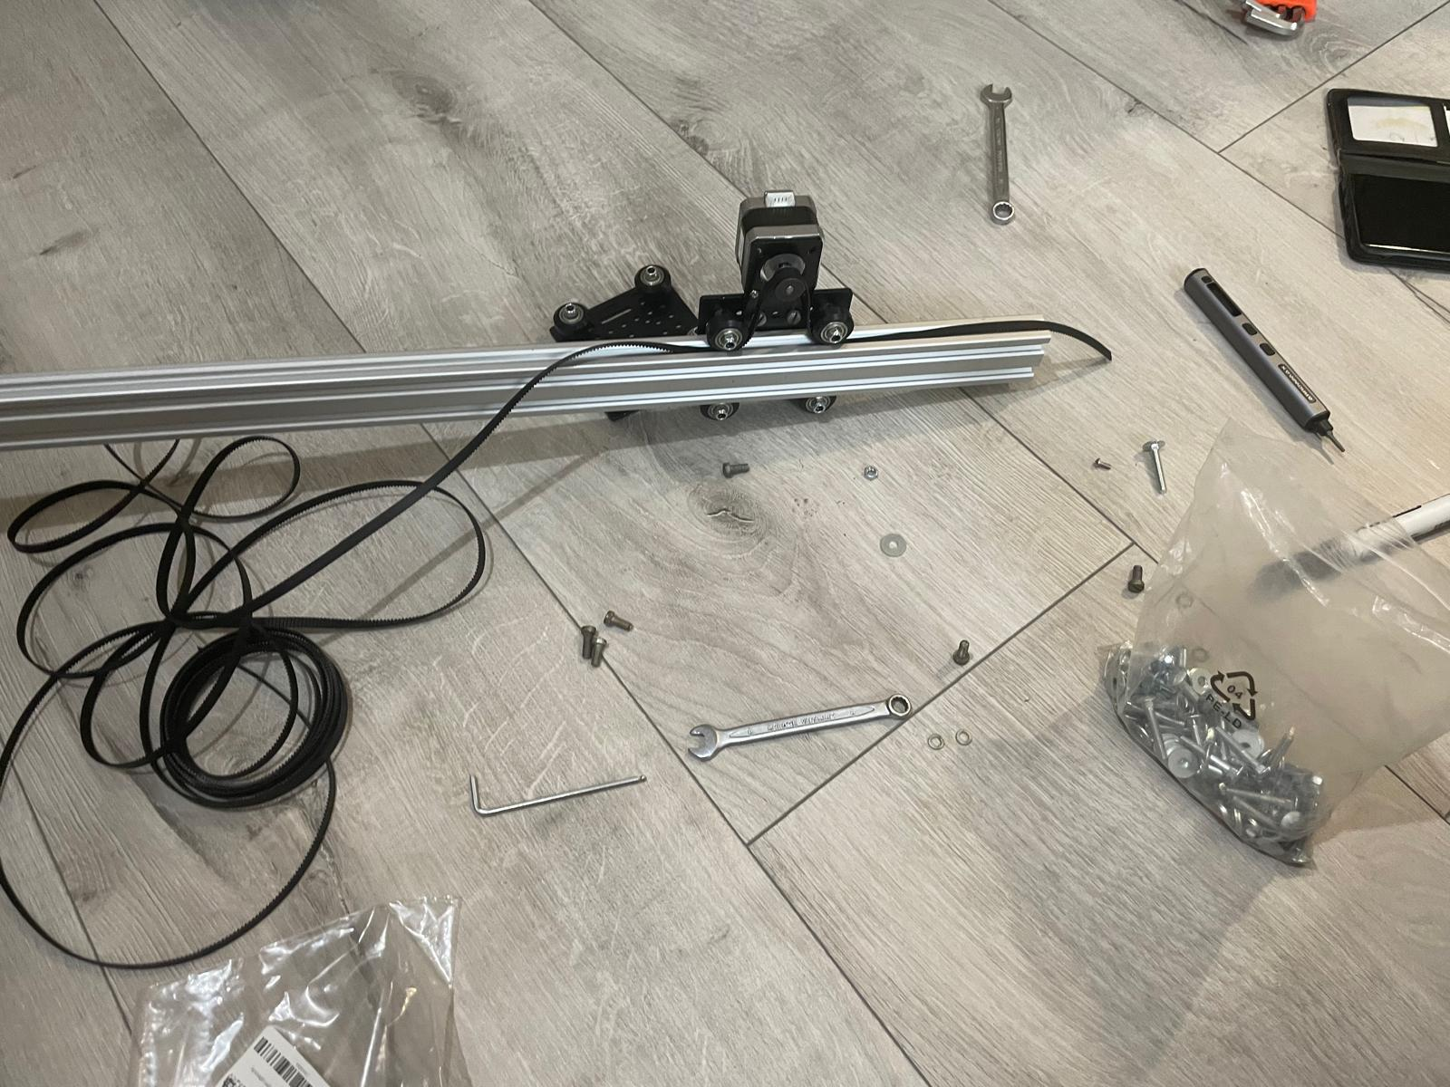
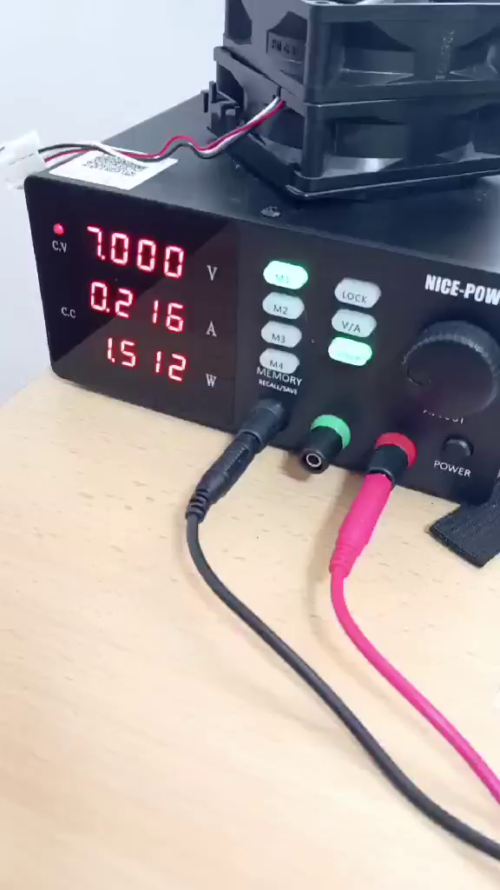
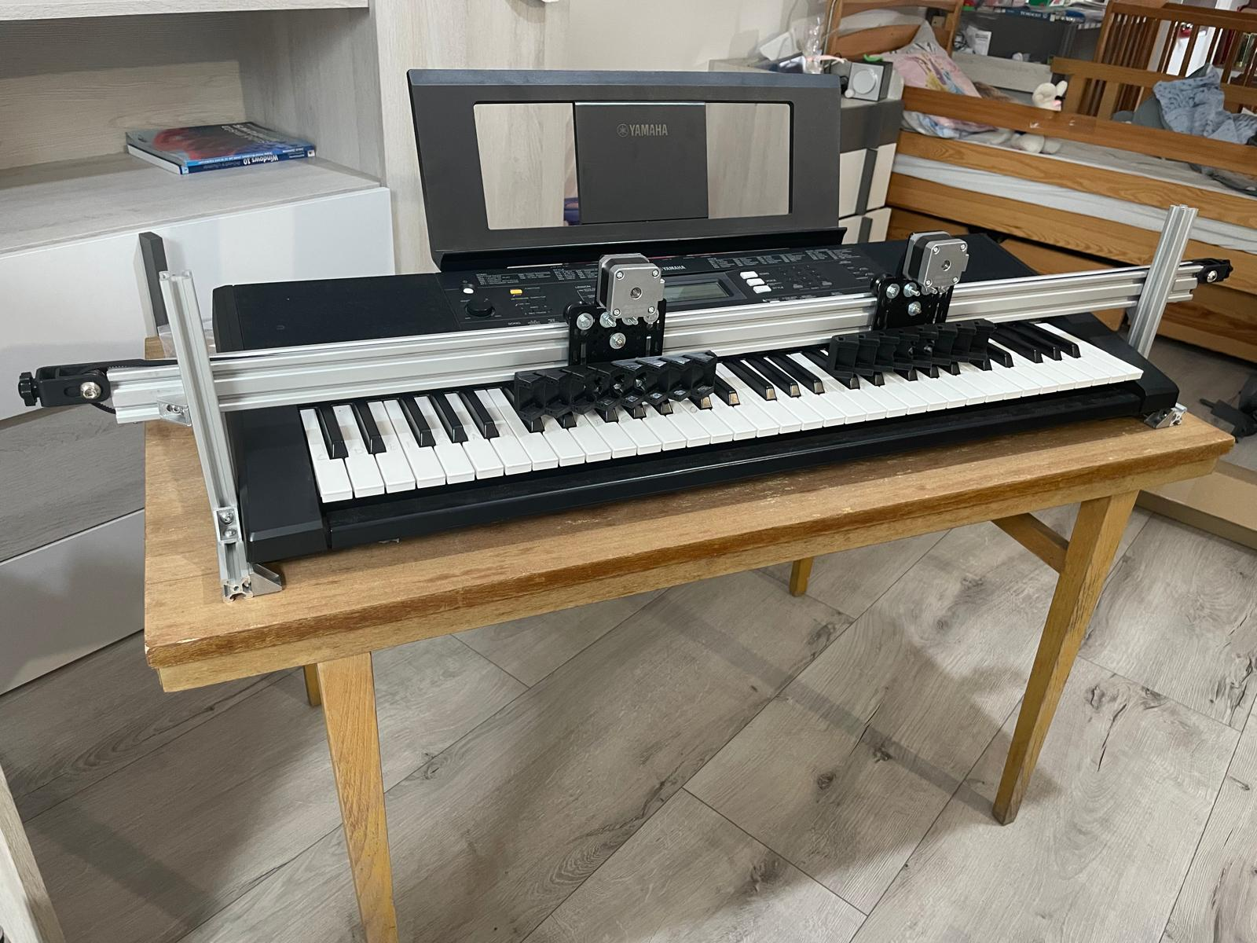
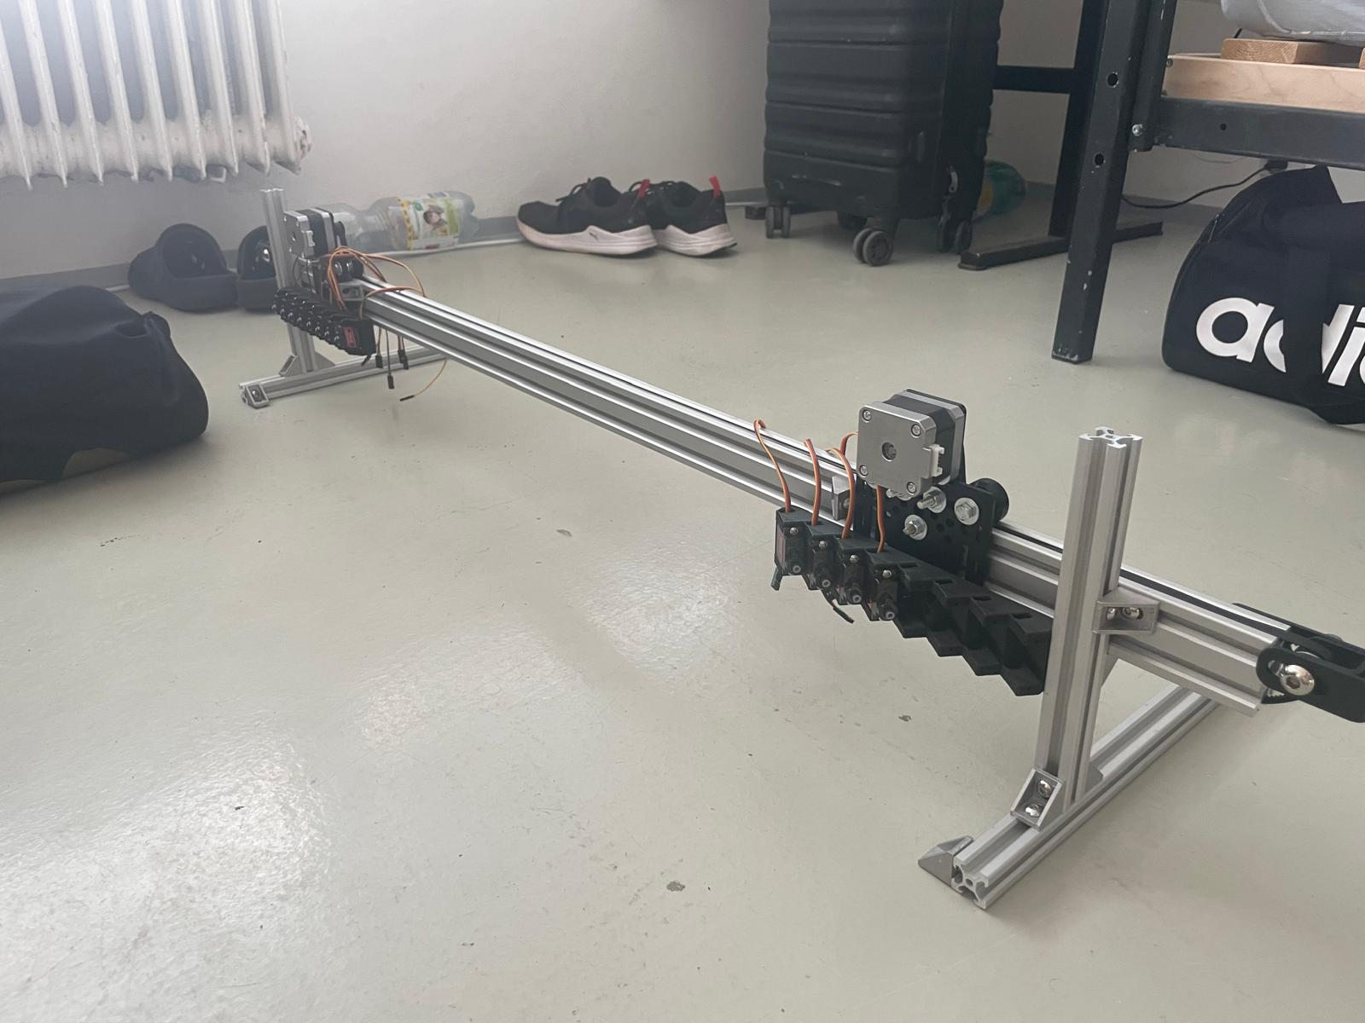
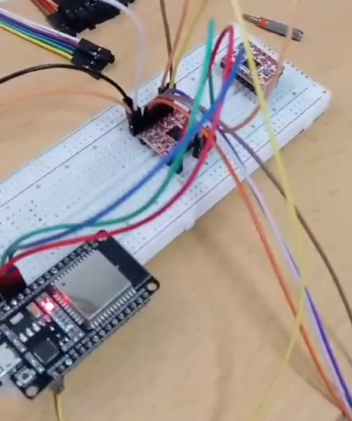
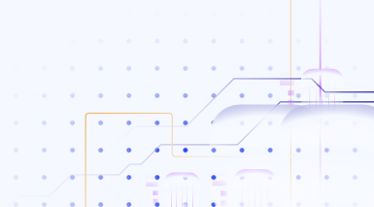
Pianist
Mechanics
Testing
kits for moving parts
belt tensioner
GT-2 belt
V-slot profiles
Electronics
MG90s servos
NEMA 17 motors
motor driver

Slide 5
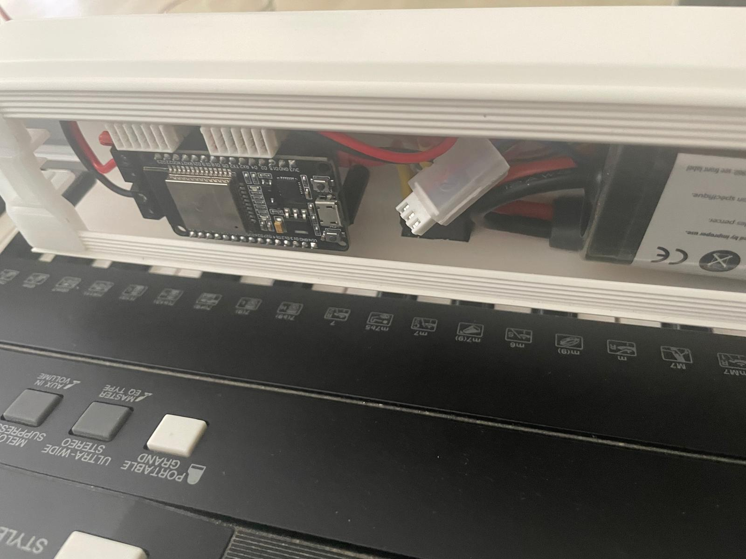
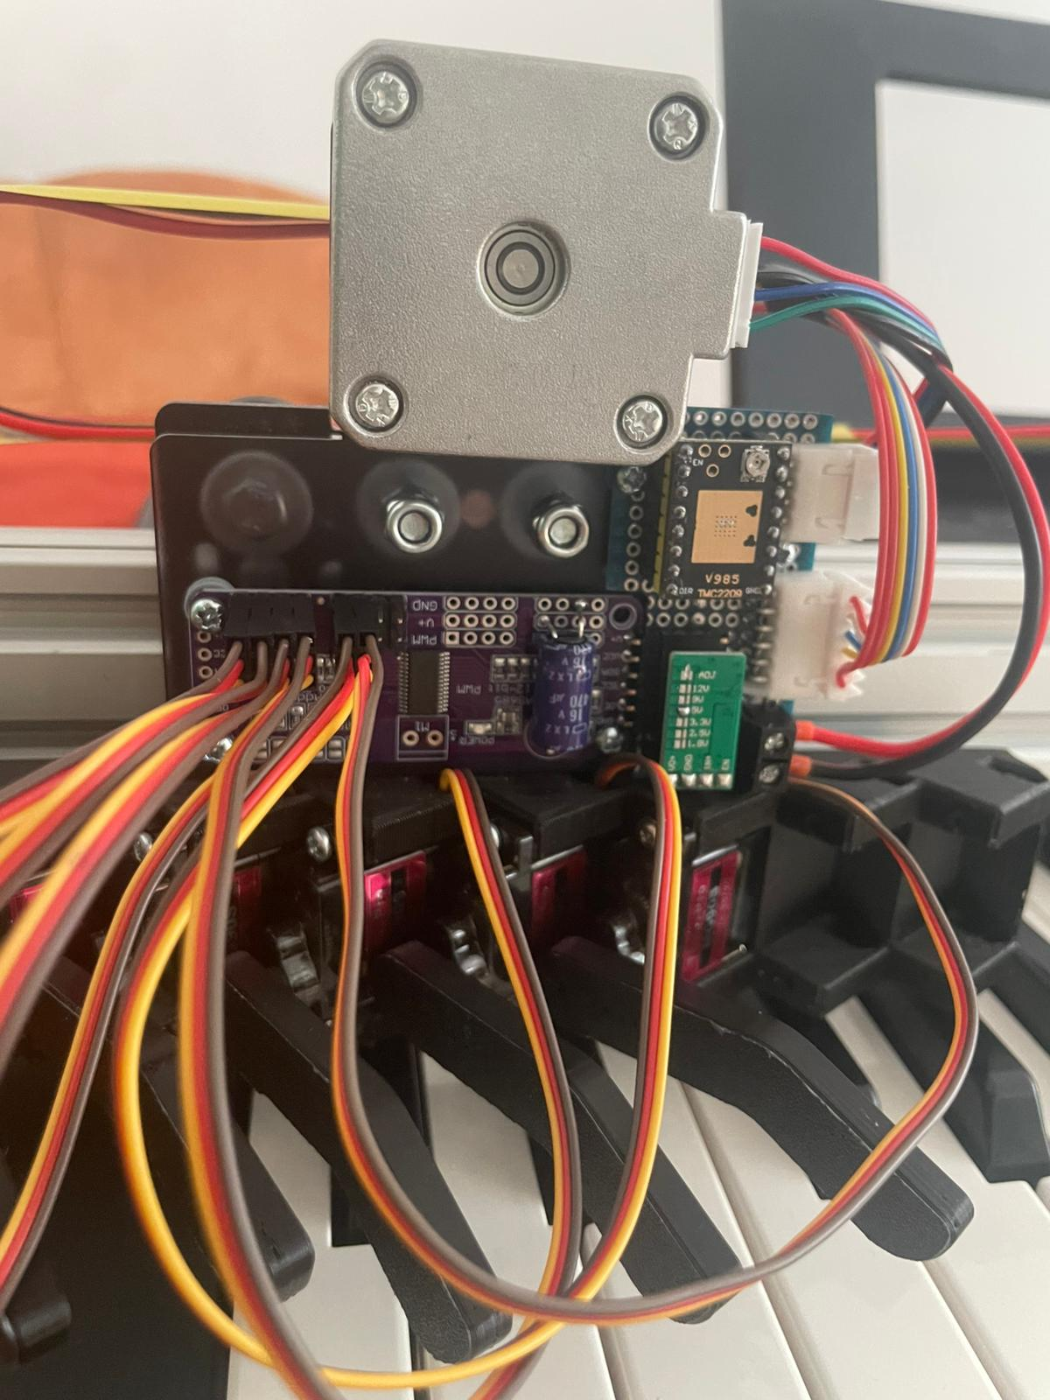
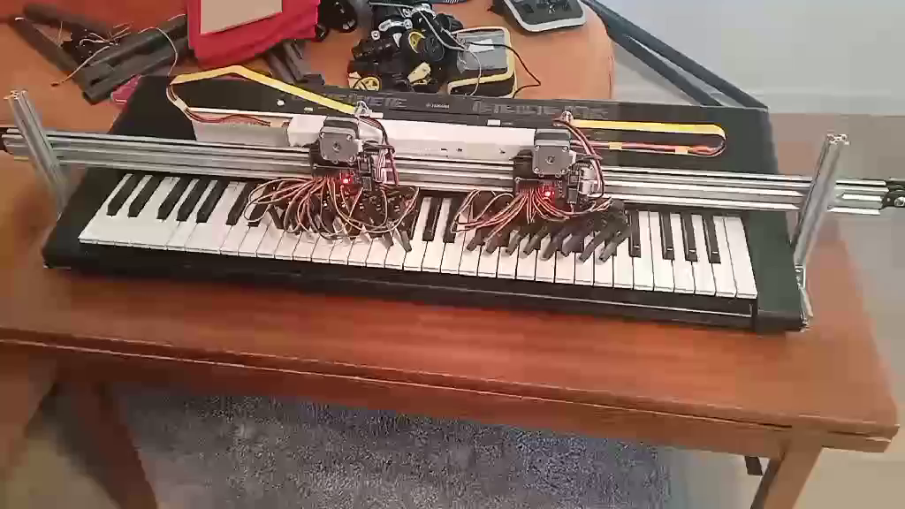
Pianist
Electronics
Testing
I2C bus
5V converter
ESP32
Li-Po battery
PCA9685 converter

Slide 6
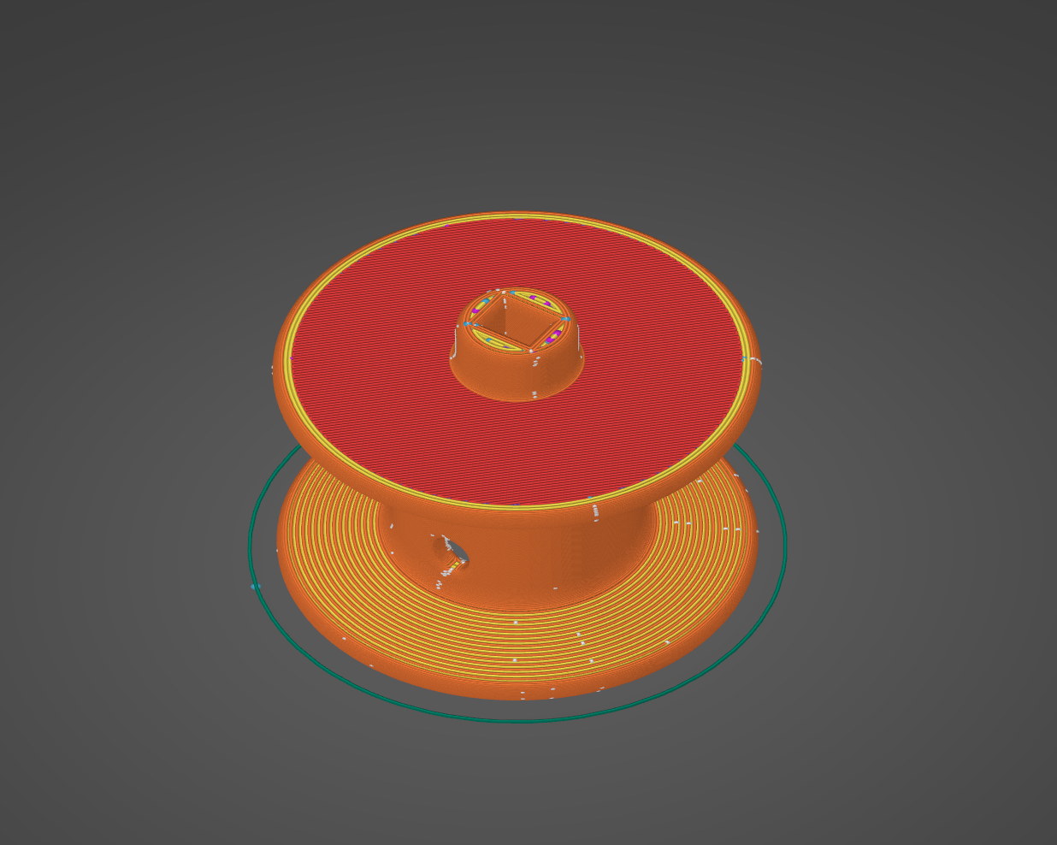
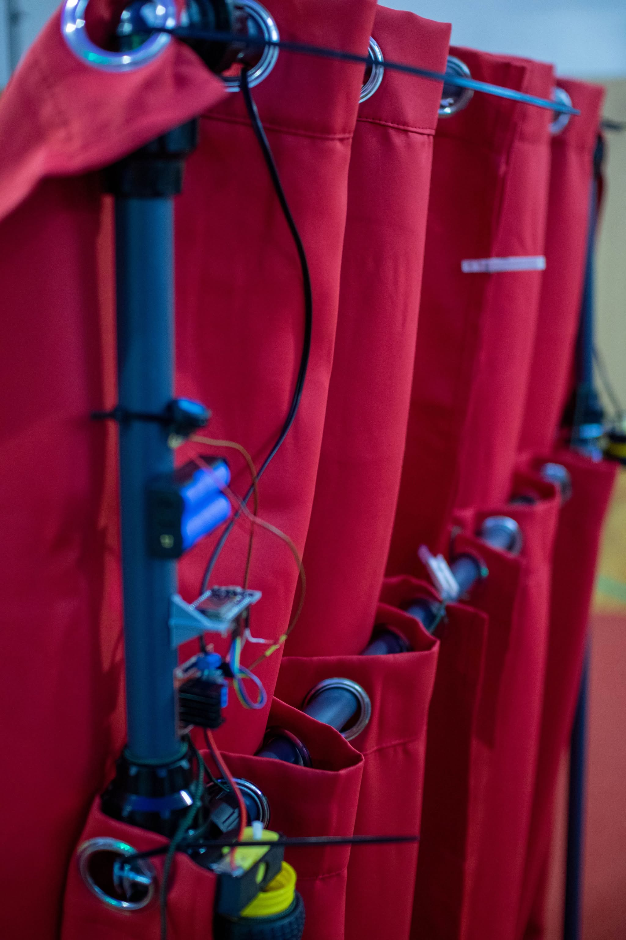
Curtains
3D printed pulley
Button
Li-ion batteries
ESP32
5V converter
motor

Slide 7
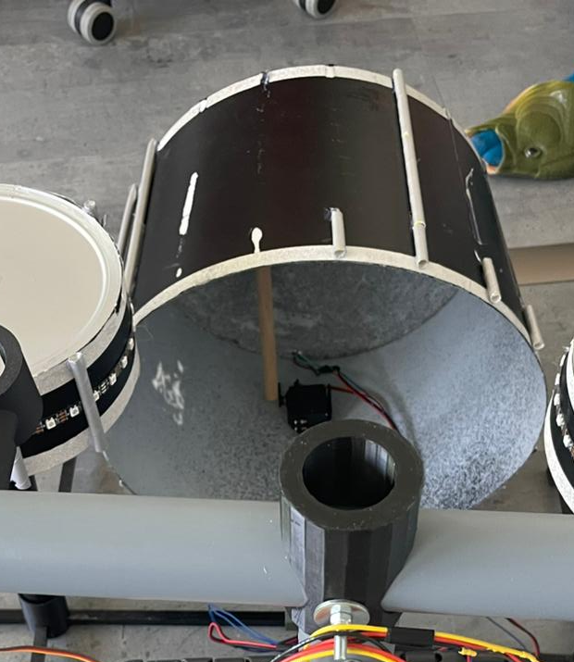
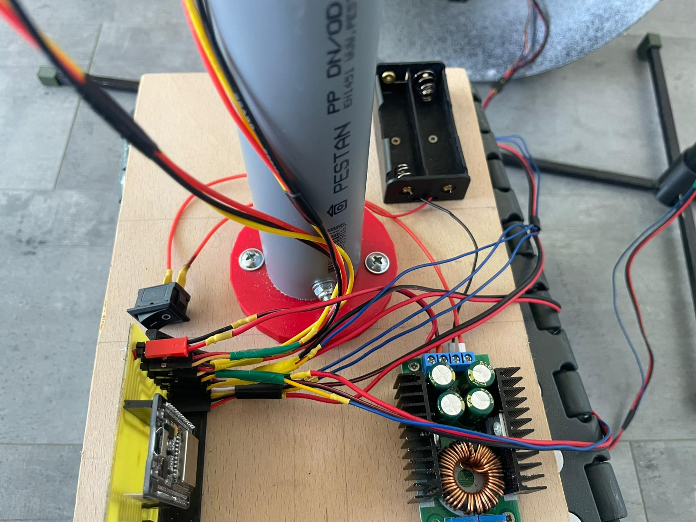
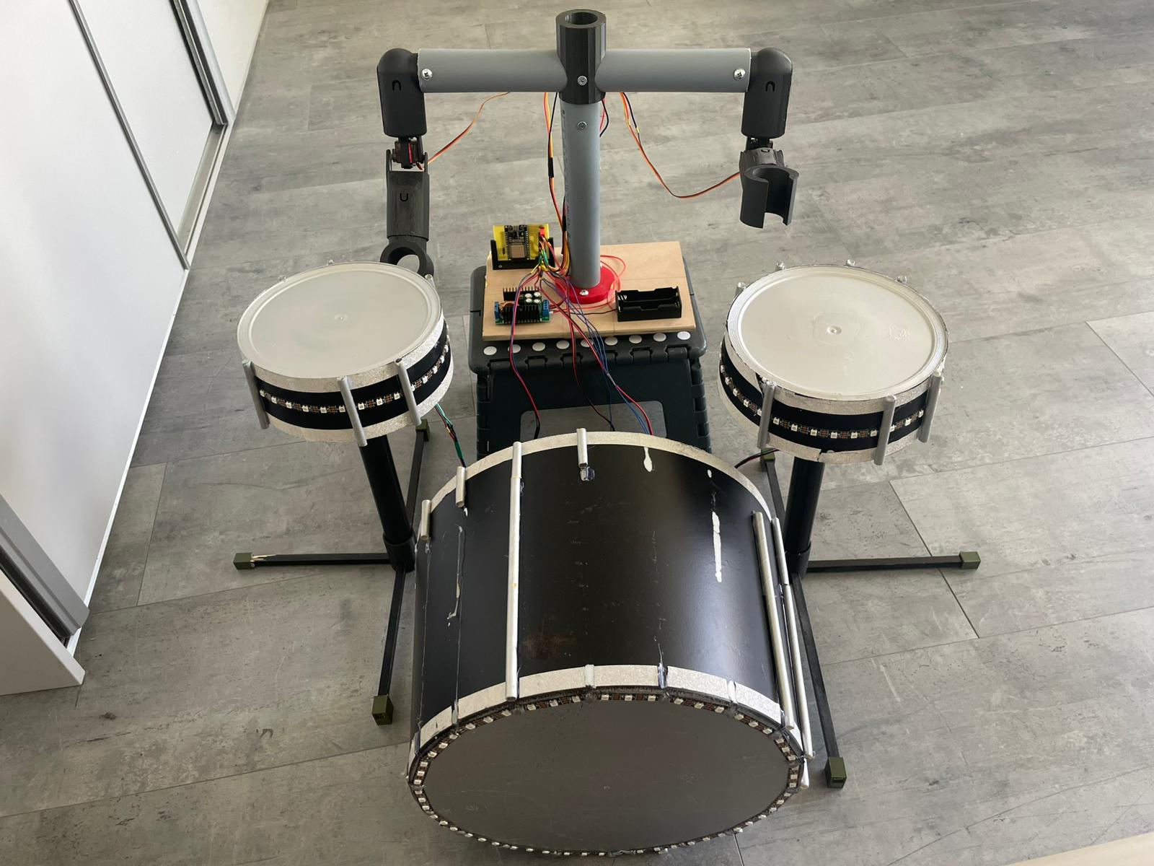
Drummer
holder for 3,7V batteries
Step down converter
MG996R servo
Led strips on drums
button
ESP32

Slide 8
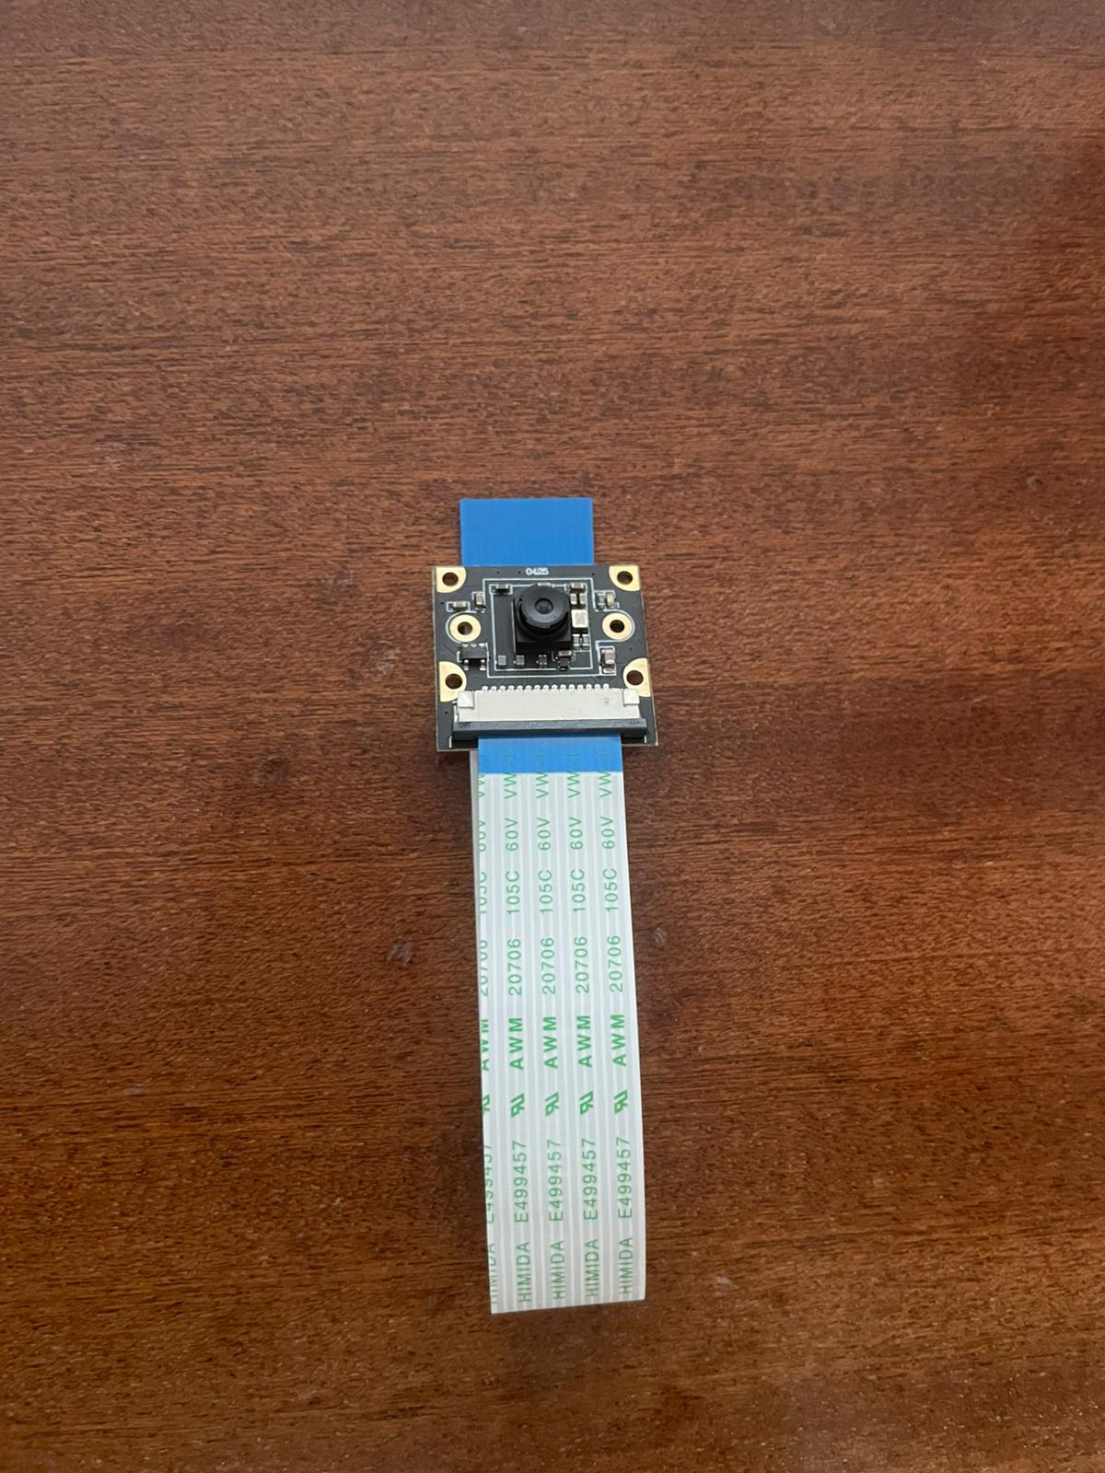
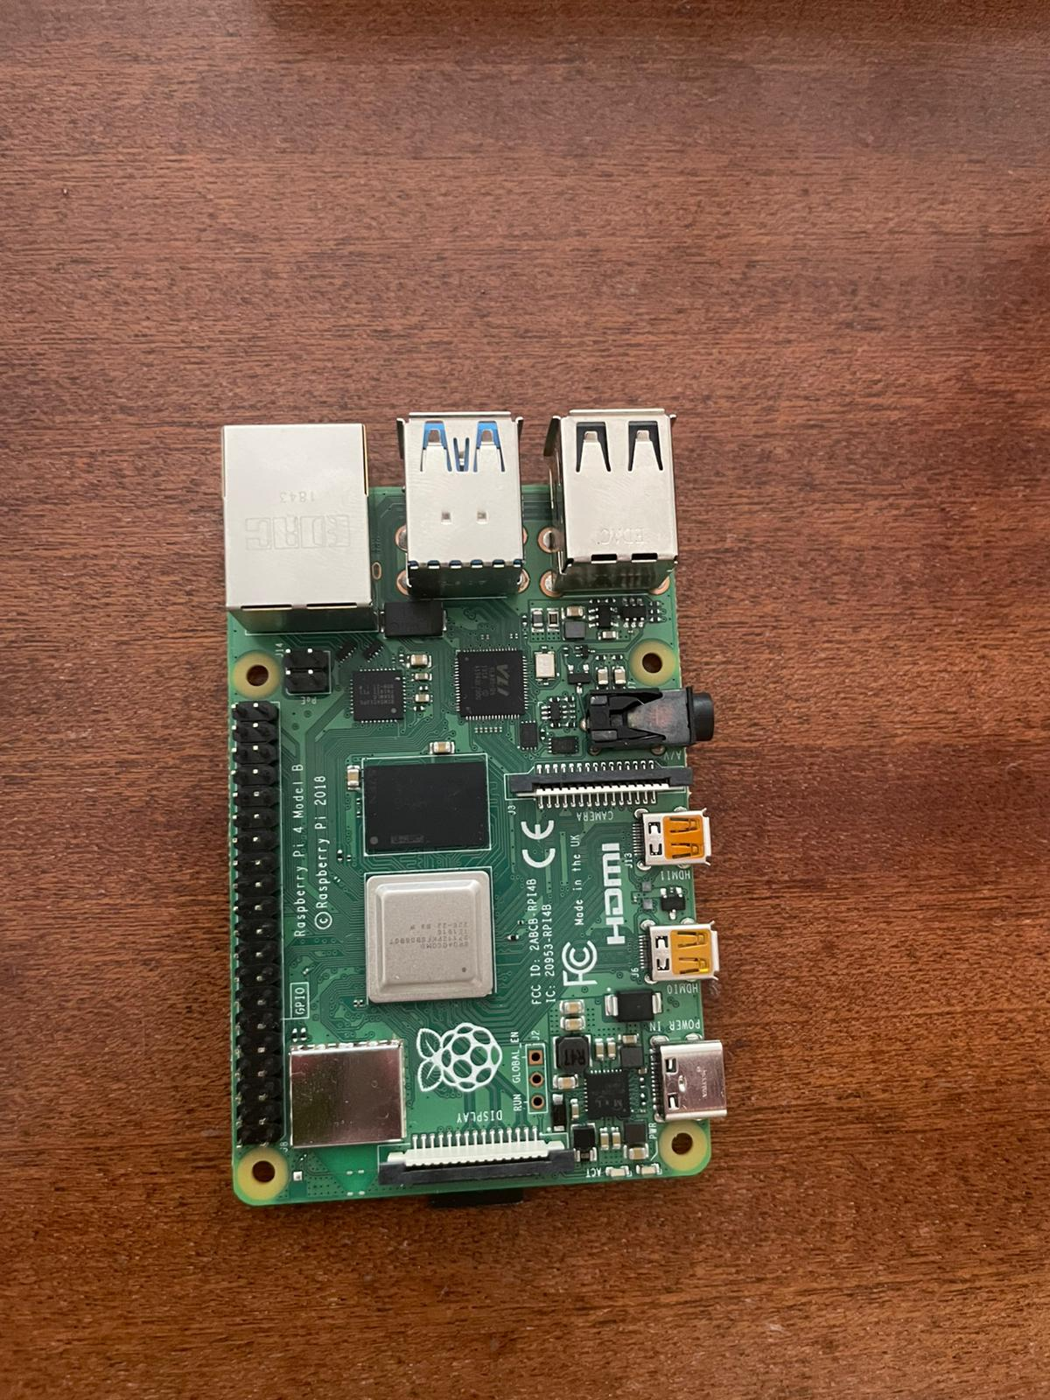
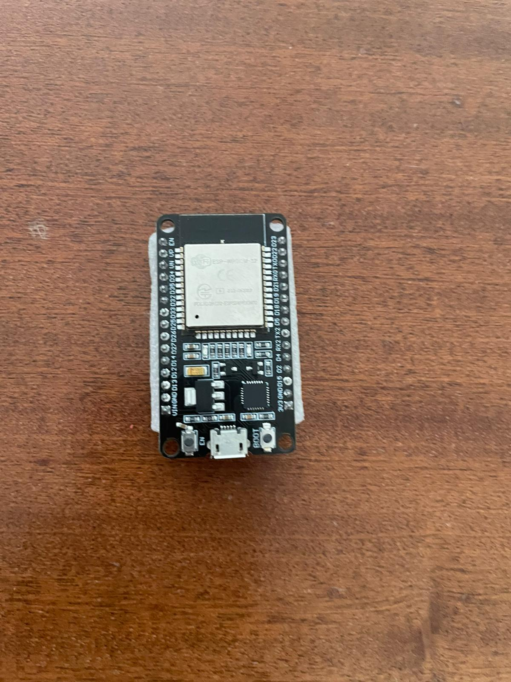
Communication
Pianist
Drummer
Input
Raspberry pi
ESP-NOW ->
Curtains
Dancer

Slide 9


Programming languages

Slide 10

Thanks for watching!!!

